Slide 1
Possibilities of shearing current profile reconstruction from X-band radar images
SOMaR-4 meeting
Pavel Chernyshov, Eyal Ginzburg, Lev Shemer, Yaron Toledo

Slide 2
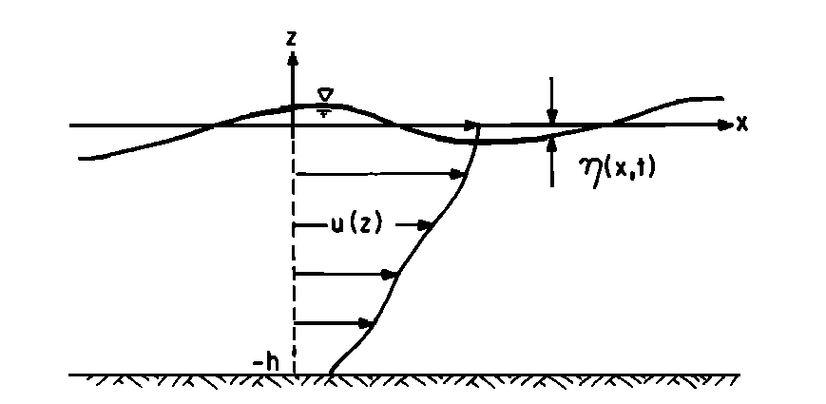
Rayleigh’s equation
Rayleigh's equation
Surface BC
Bottom BC
Stewart & Joy (1974): deep water, a weak currents,
small gradients and curvatures assumptions
Skop (1987): same for any water depth
Kirby & Chen (1989): second order for any water depth
Shrira (1993): deep water, only a small curvature assumption
Notes:
2

Slide 3
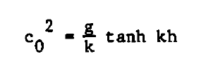
Solutions of Rayleigh's eqn.
Rayleigh's equation
Surface BC
Bottom BC
Stuart & Joy (1974); Kirby & Chen (1989)
Skop (1987), Kirby & Chen (1989)
Notes:
3

Slide 4
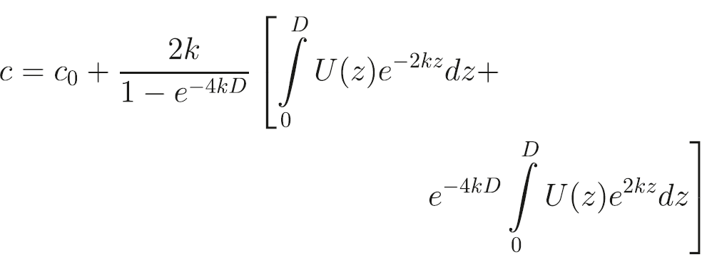
Skop solution
where
Skop R. A. An approach to the analysis of the interaction of surface waves with depth-varying current fields//Applied mathematical modeling. 1987. Vol.11. No 6. P.432-437

Slide 5
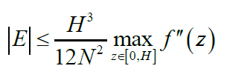
Trapezoidal integration

Slide 6
Minimization formulation

Slide 7
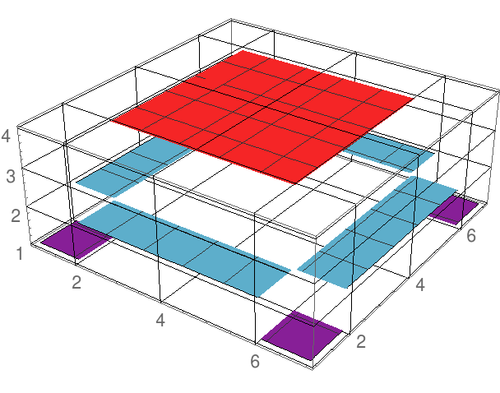
Matrix formulation
- Discrete Heaviside’s function

Slide 8
Retrieval from an exact surface function

Slide 9
Noise sensitivity

Slide 10
Regularization
Minimization of the functional
- Trial solution
- Lagrange multiplier

Slide 11
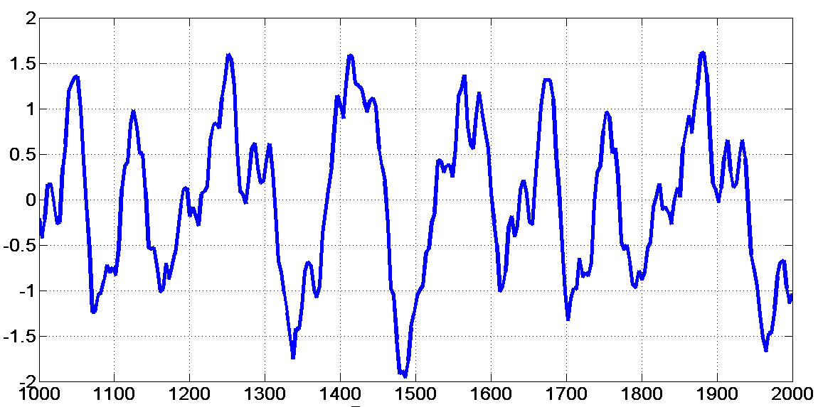
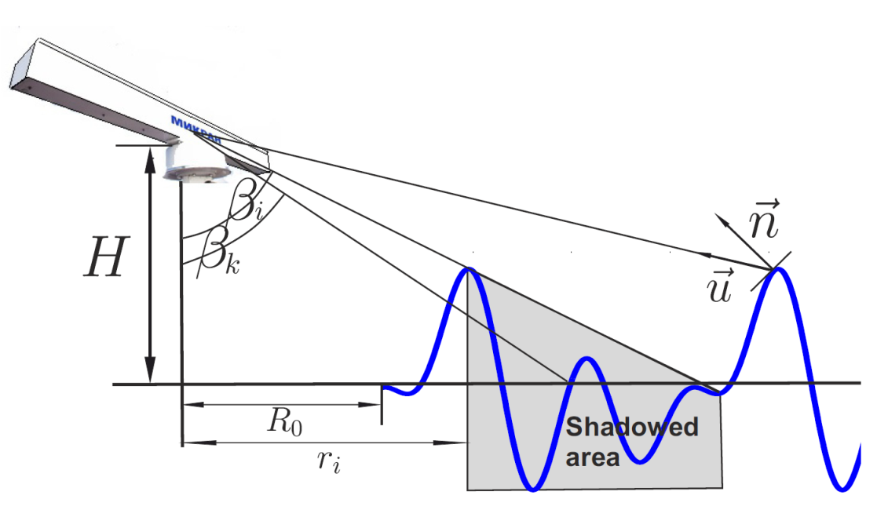
Radar image simulation
Random sea surface simulation
(space and time)
Imaging mechanisms (shadowing,
tilt modulation, speckle noise)
2D Fourier analysis
undulated sea surface realization
real image
(1D section)
simulated
(no noise)
simulated
(with noise)

Slide 12
2D Fourier analysis
Depth,m

Slide 13
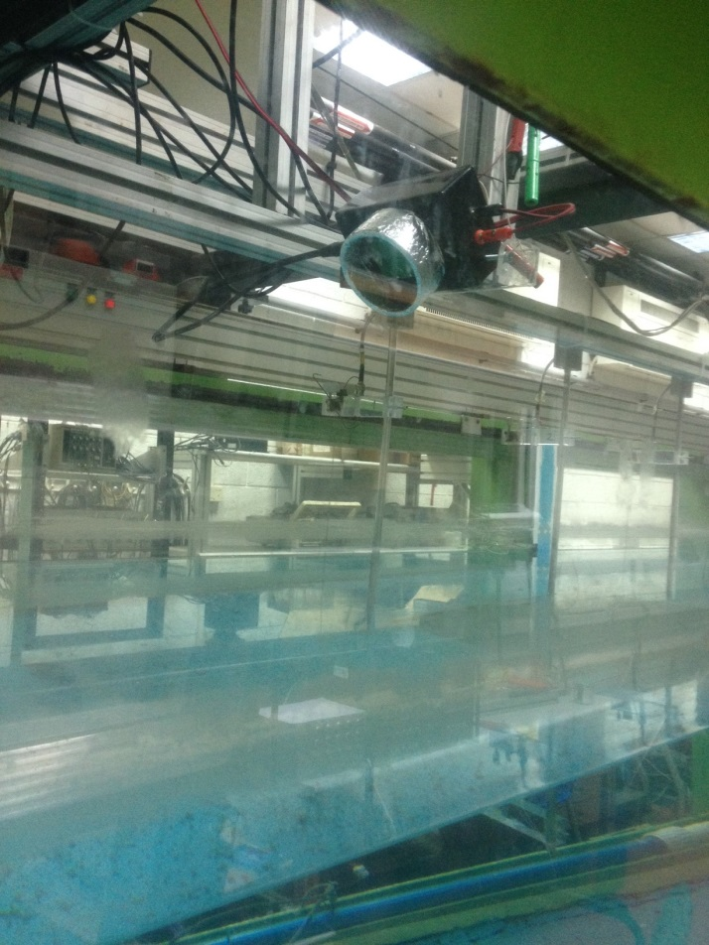
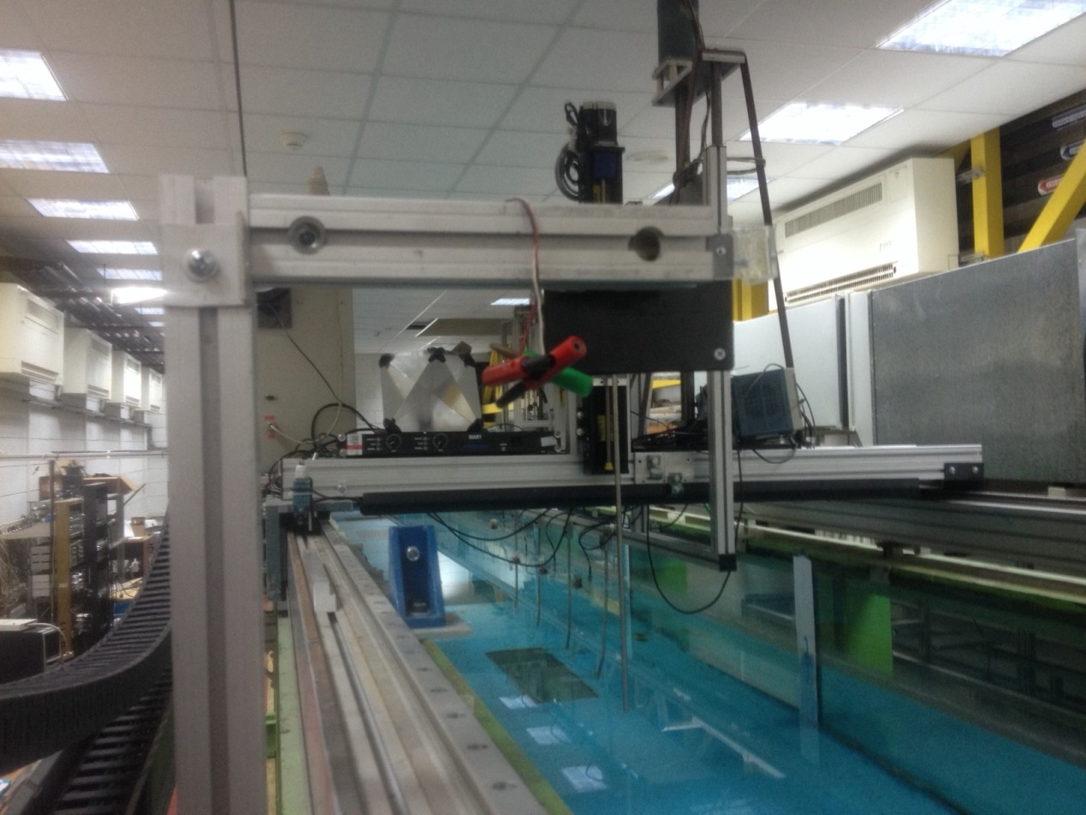
Velocities measurements with a Doppler shift X-Band Radar

Slide 14
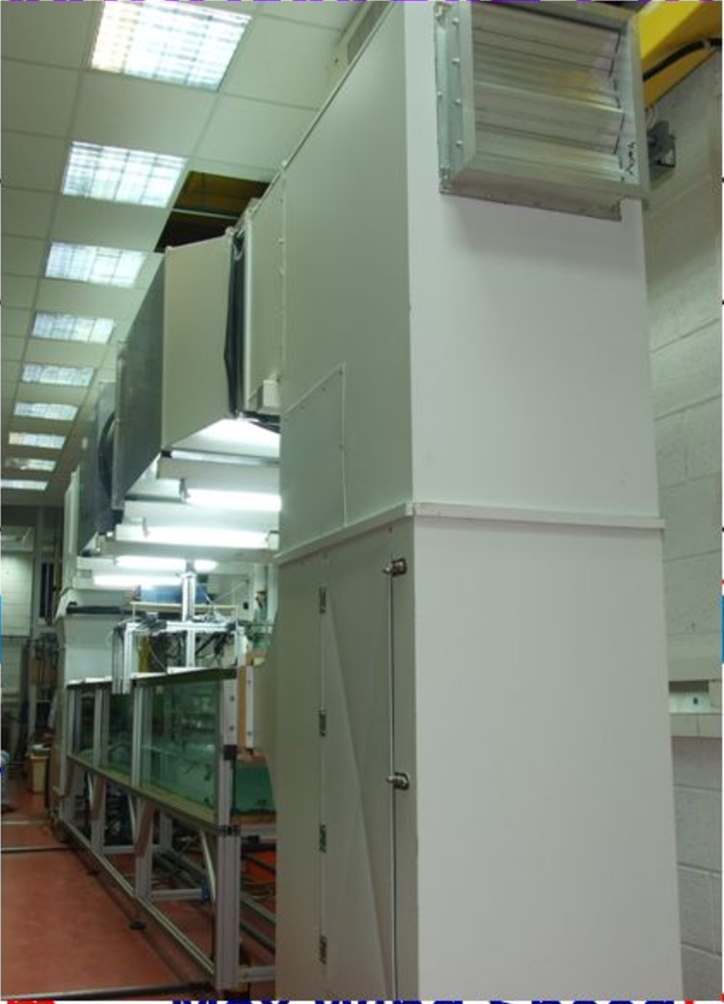
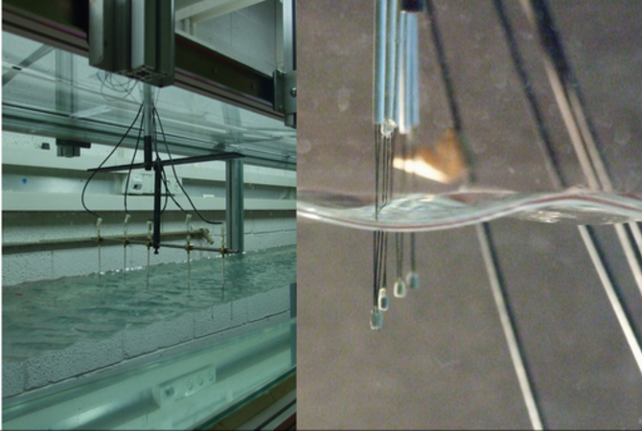
Wind-wave-current tank

Slide 15
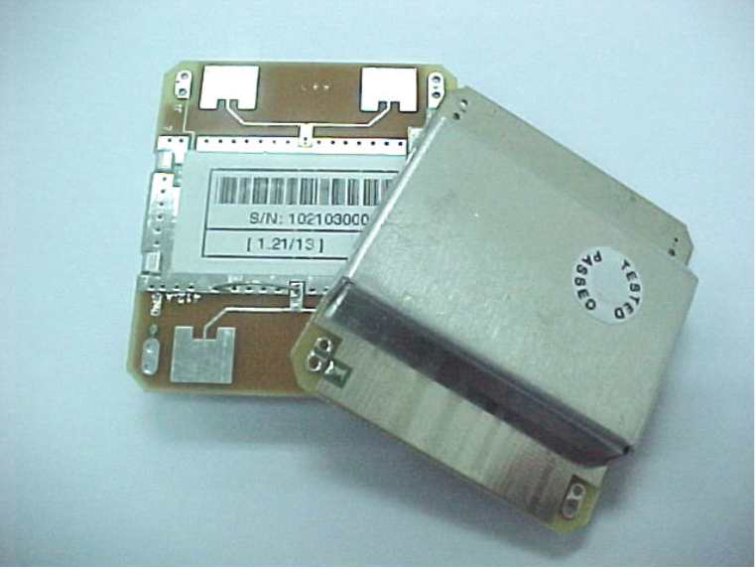
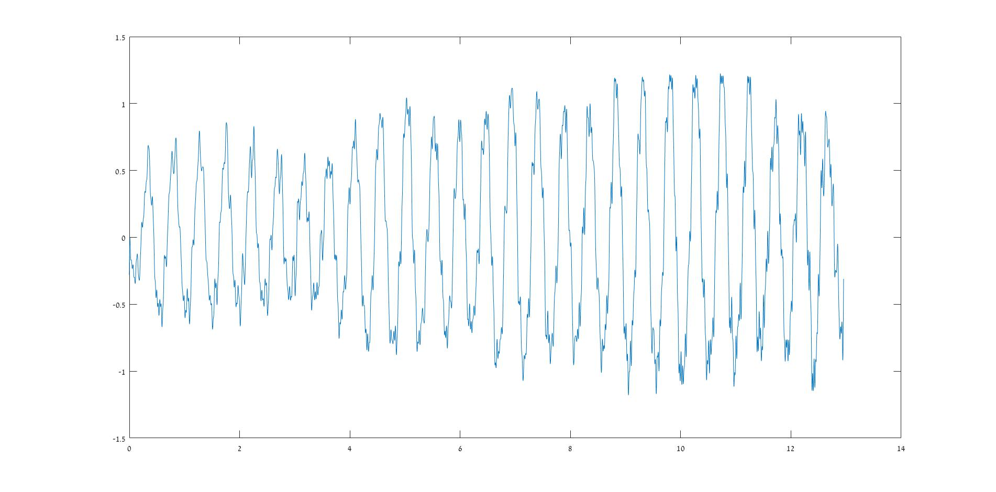
Small Doppler X-band radar
A Doppler based X-Band Radar (HB-100) was fixed above 2 flume channels.
The radar was pointed towards moving objects (velocity controlled carriage / water surface)
and the raw signal (phase change in time) of the radar was recorded.
F=10.525GHz, Lbragg=1.4cm /cos(theta)
*The raw signal of the radar, pointed to a carriage, moving away in constant speed

Slide 16
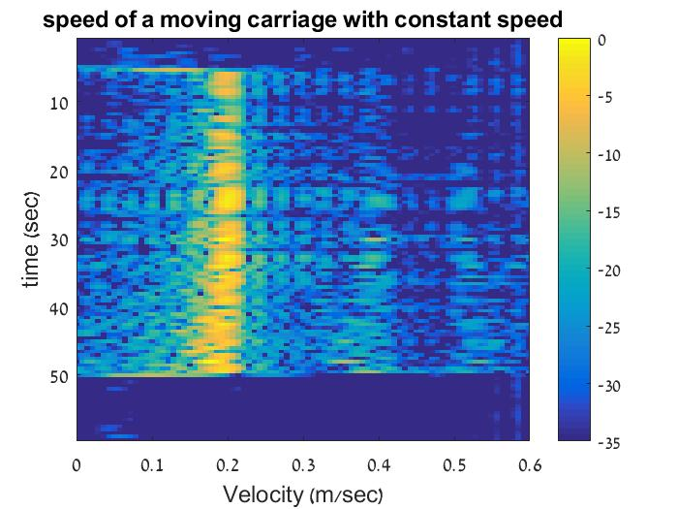
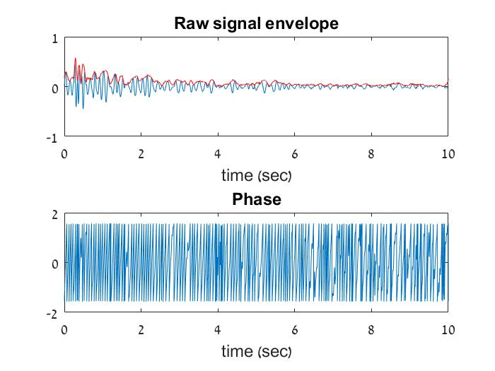
Data Analysis Methods
FFT: Fourier Transform over time intervals, getting the velocity from the Doppler equation.
Hilbert Transform: The phase in time as well as the signal’s envelope are carried out, then converted to speed over time.
Window = 0.25sec

Slide 17
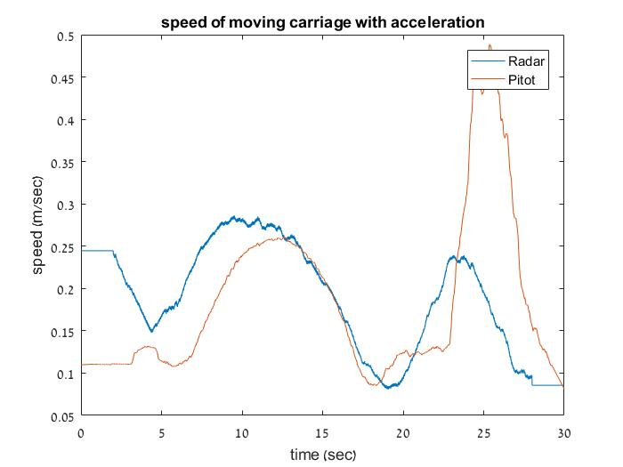
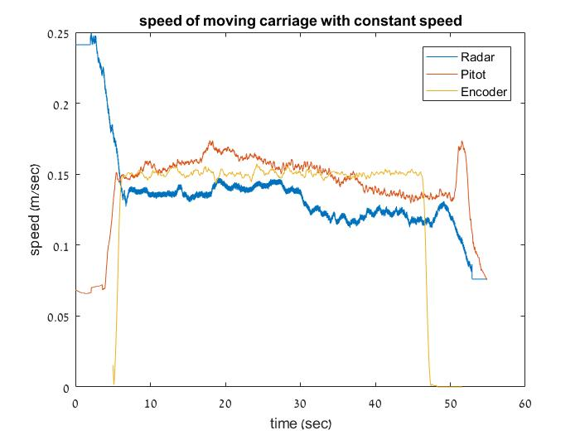
Results Validation
The moving carriage speed, as well as the water movement speed was measured with the carriage movement encoder and a pitot-differential pressure system, correspondingly.
Then the signals were compared.

Slide 18
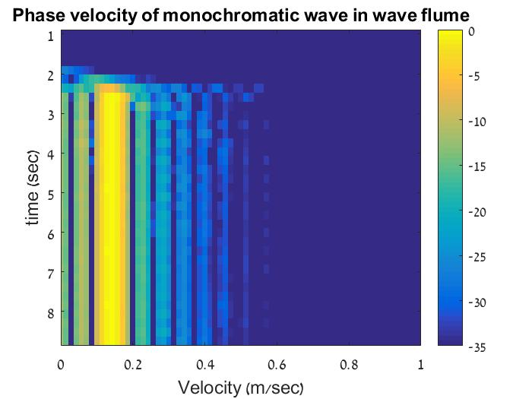
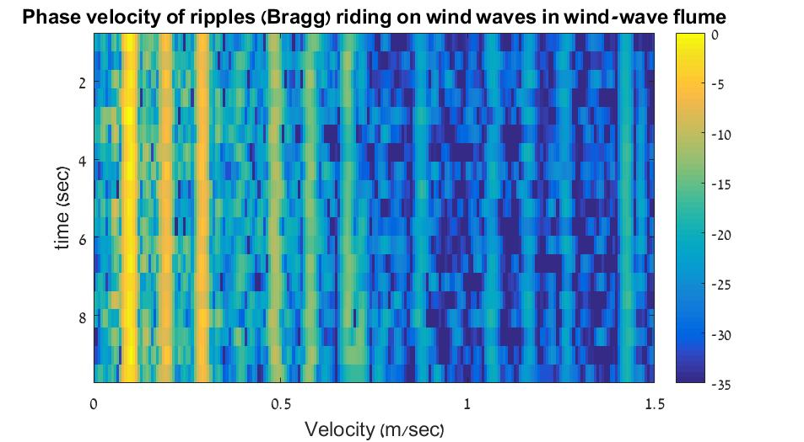
Some preliminary results
T = 0.4 sec
C=0.5 m/sec
Monochromatic wave
Wind spectra
Uwind=0.85m/sec

Slide 19
Thank you!

