Slide 1
The Langmuir Cell Dri dataset Taken March/April 2017
Presented to SOMaR-4 Fourth Workshop on Sensing the Ocean with Marine Radars
9-11 May, 2017, Lüneburg, Germany
Tony de Paolo
Dr. Eric Terrill
Scripps Institution of Oceanography

Slide 2
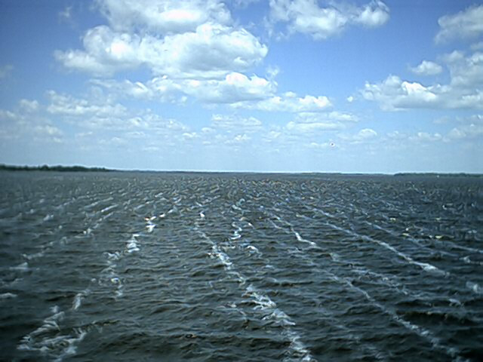
From the proposal…..
Langmuir cells are one of many physical processes at the air-sea interface that couple the ocean-atmosphere system, and are responsible for extending the influence of the air-sea interface to depth. Langmuir cells vary significantly in time and space, and traditional means to sample them have been cumbersome, resulting in data sets that don’t span wide ranges of conditions. In particular, situations when the winds and waves aren’t aligned, and in conditions of varying stratification.

Slide 3
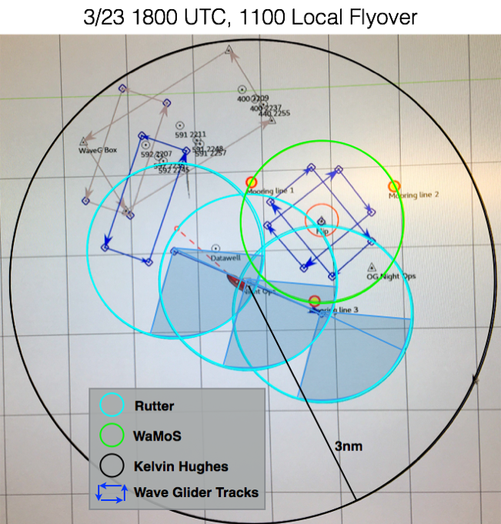
Sampling plan
3 X-Band Radars
Furuno/WaMoS II (FLIP)
Sperry/Rutter/WaMoS II (Sally Ride)
Kelvin Hughes (Sally Ride)
2 Liquid Robotics Waveglider SV3s
3 Hydroid Remus AUVs
Moored Datawell buoy (with SIO mini wave buoy TopHat)
4 drifting SIO mini wave buoys
Ken Melville’s Group (SIO)
Jerry Smith’s Group (SIO)

Slide 4
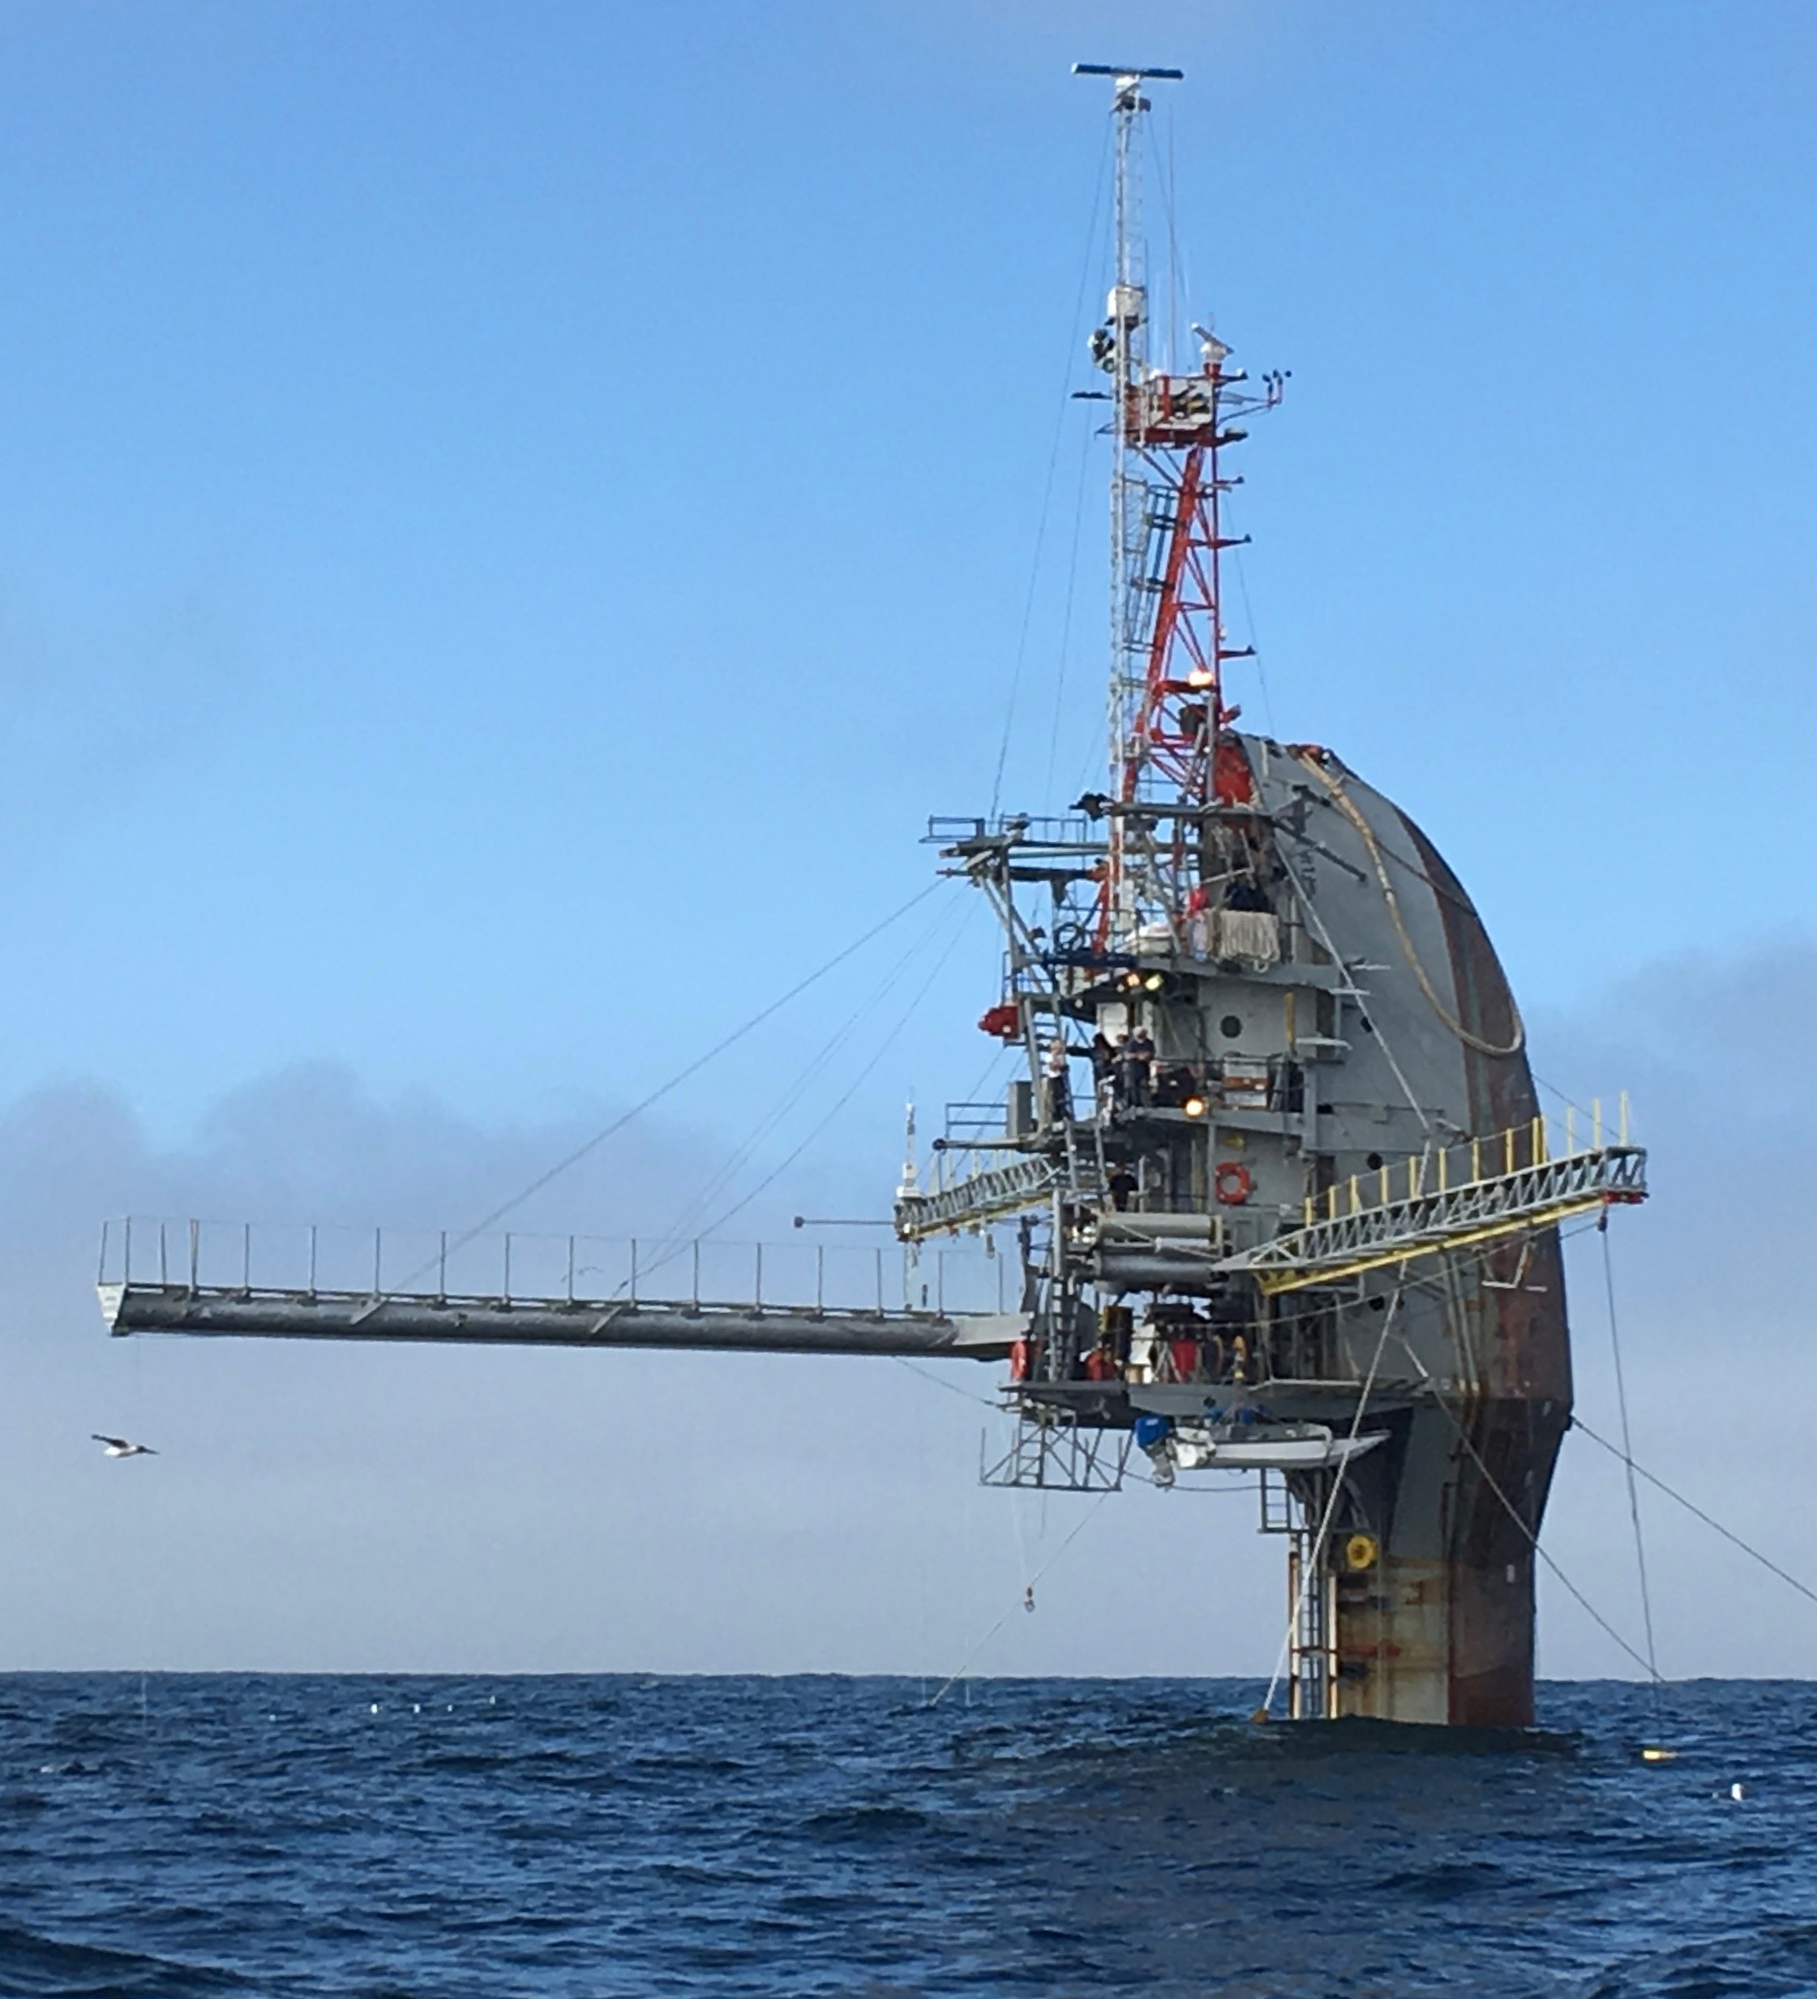
X-Band Radars
WaMoS Tower
Kelvin Hughes Tower
Rutter

Slide 5
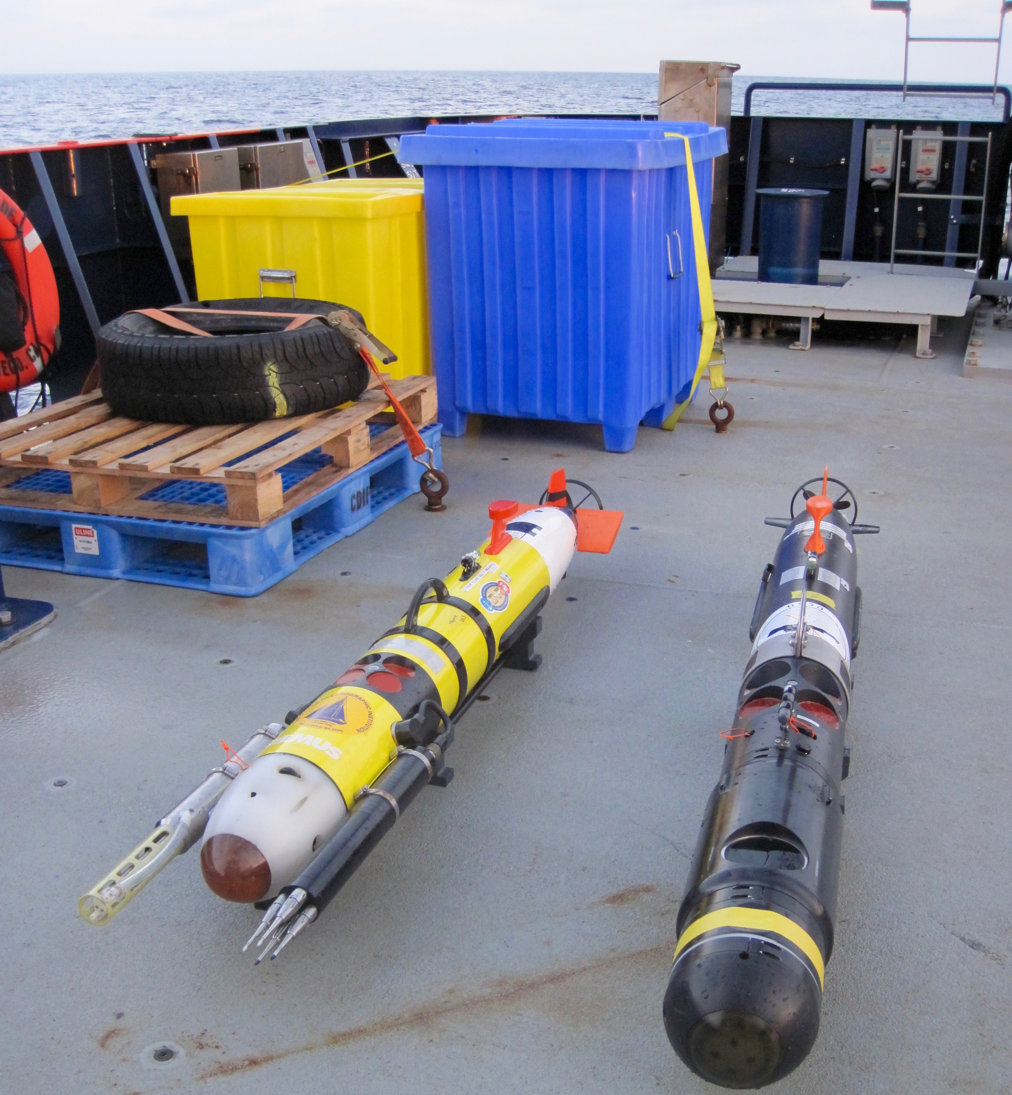
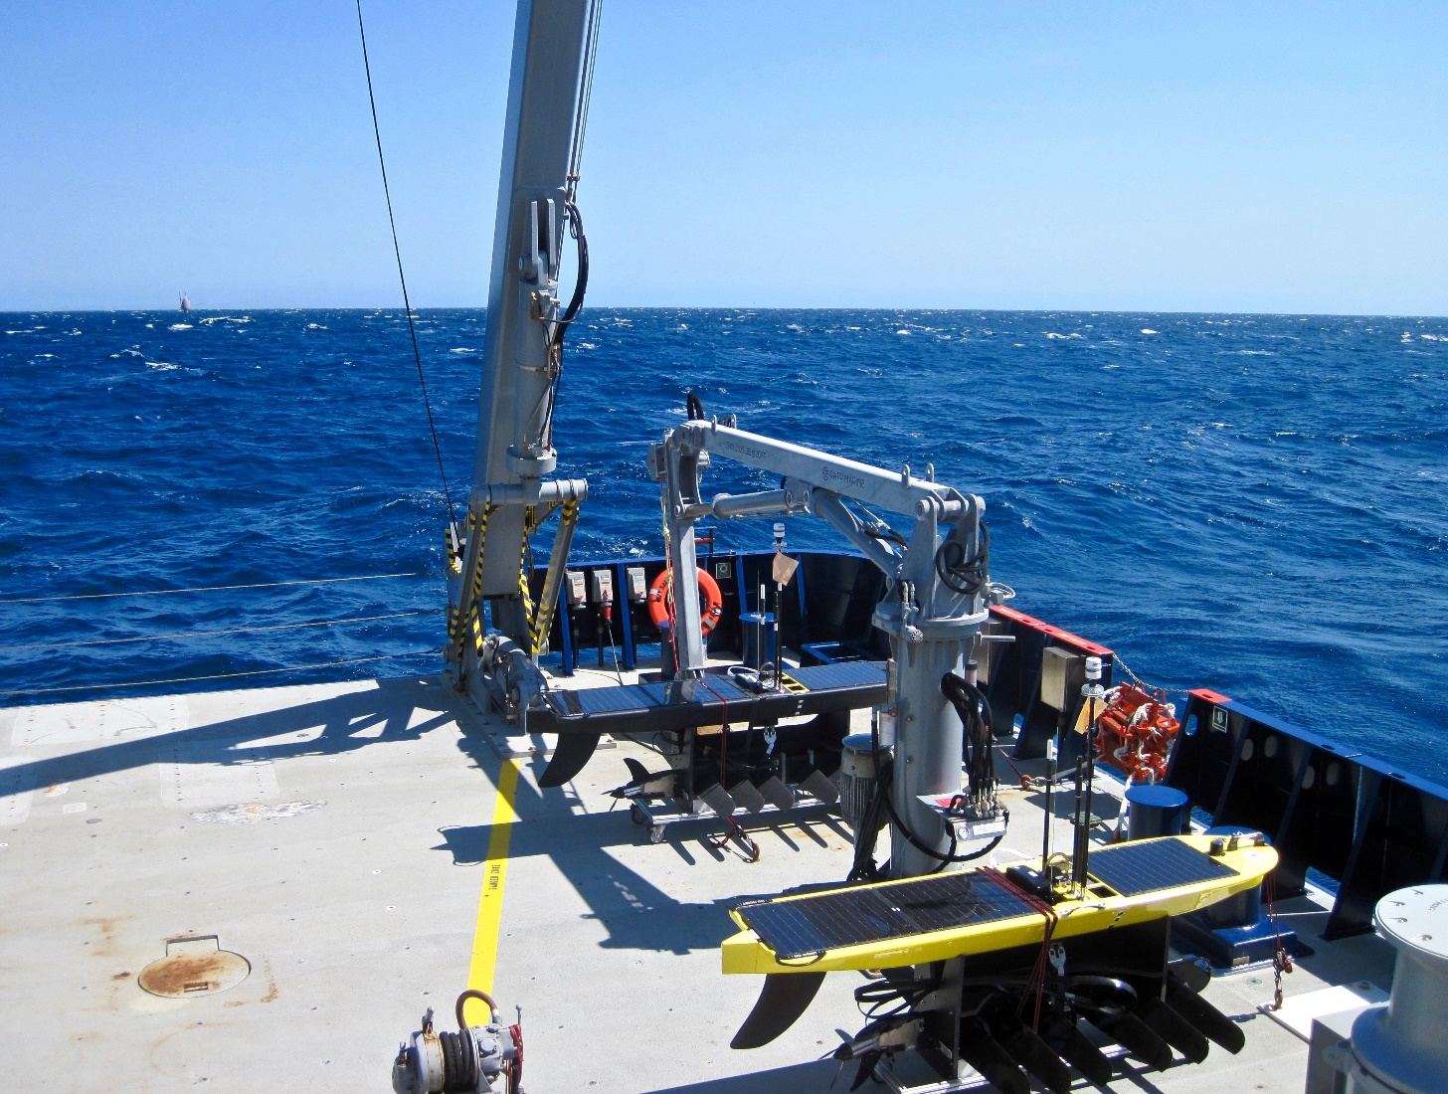
Autonomous Vehicles

Slide 6
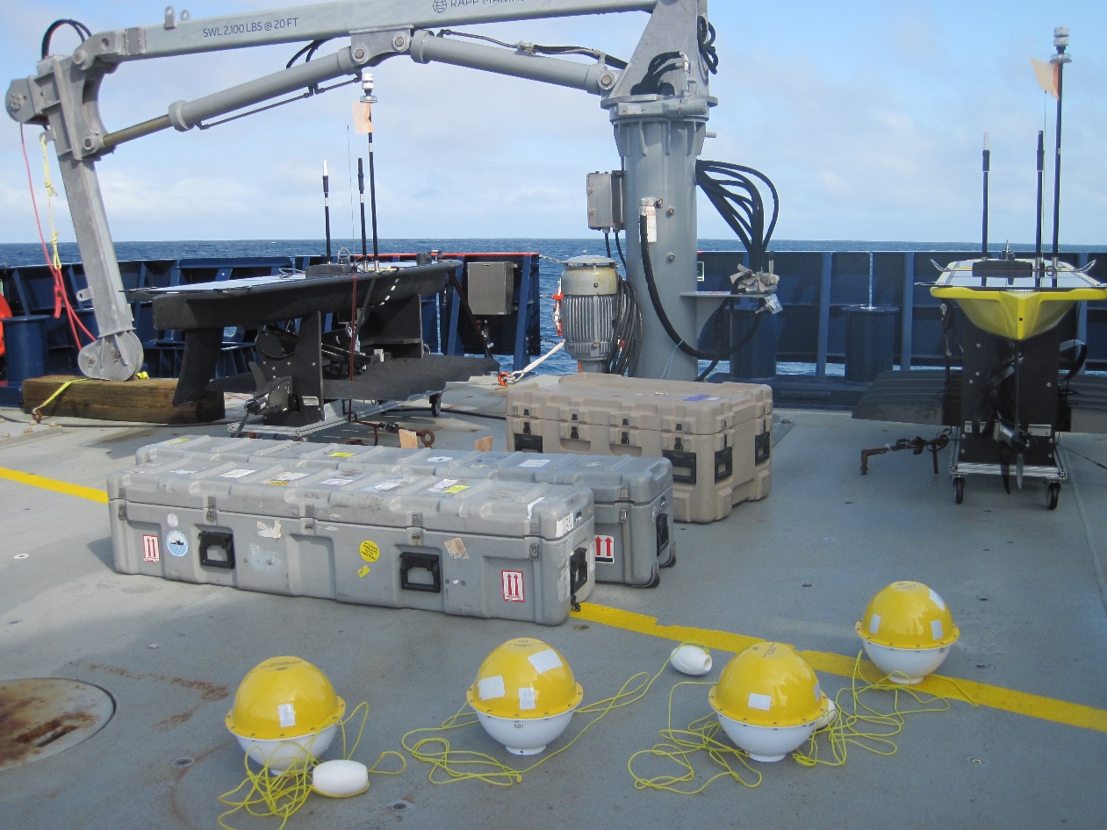
Wave Buoys

Slide 7
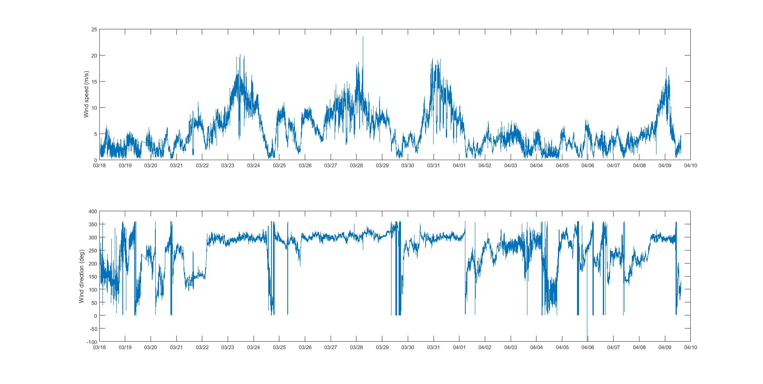
Winds

Slide 8
Wave Buoy Data

Slide 9
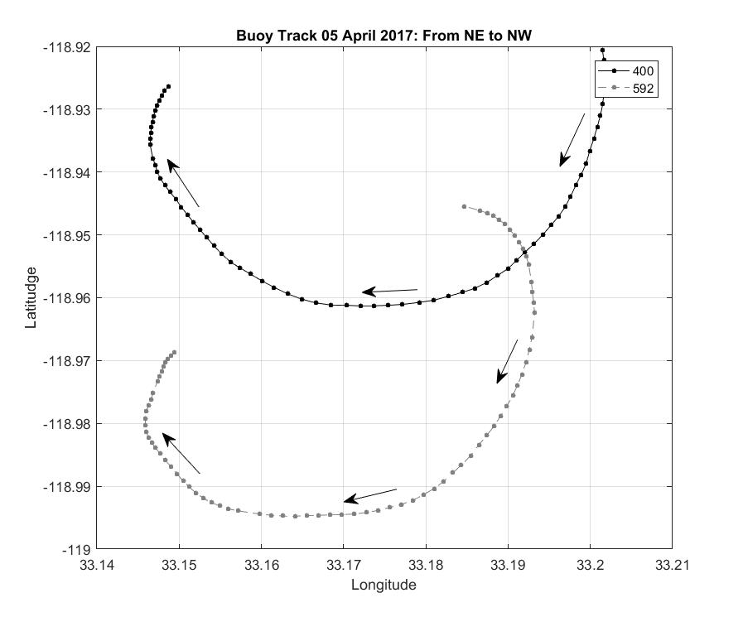
Wave buoy Data
Daily counter clockwise circulation
patterns.
Strong diurnal currents

Slide 10
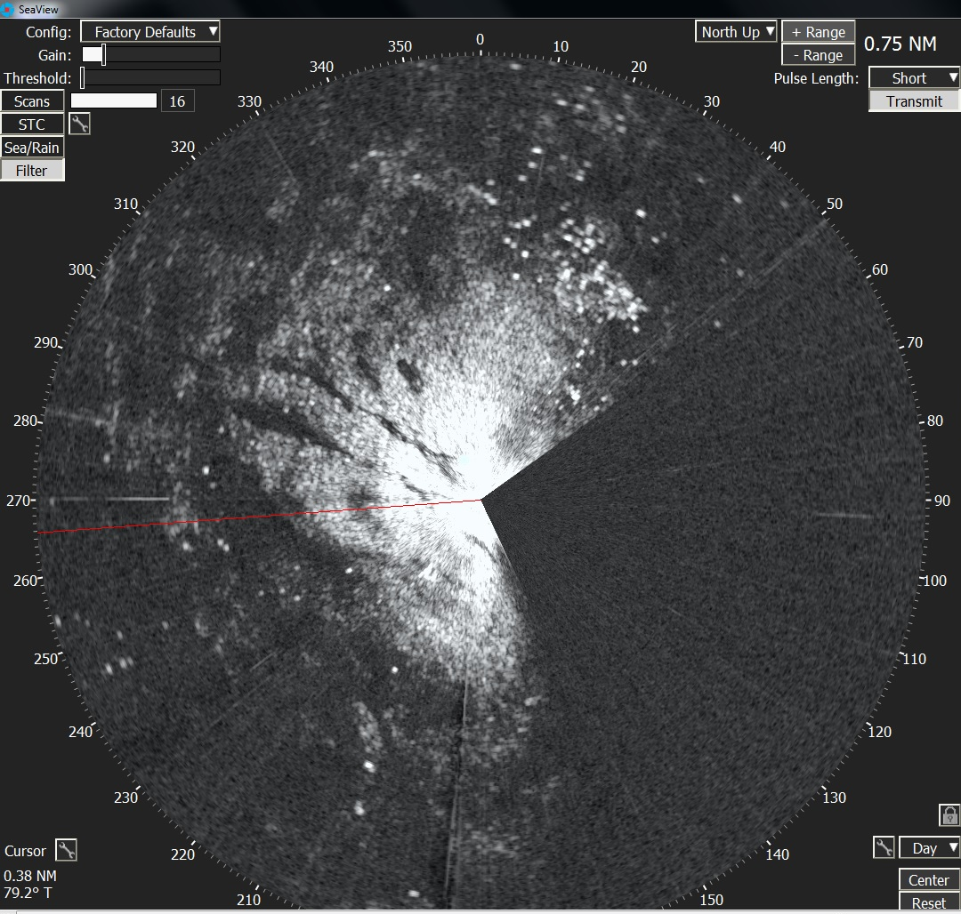
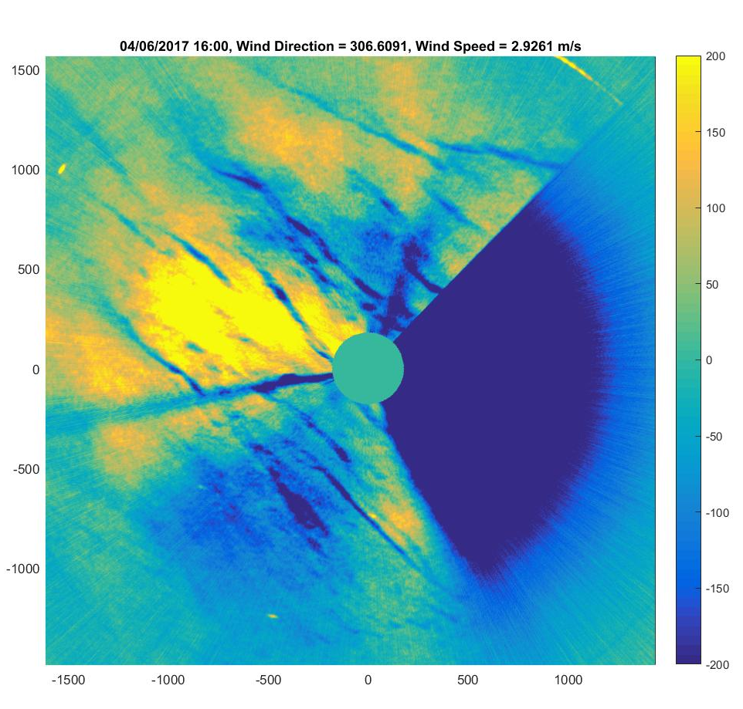
Sally Ride Rutter/Wamos Langmuir Cells in Radar image One minute average

Slide 11
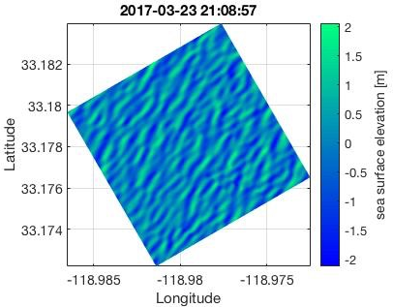
Sally Ride Rutter Wamos wave inversion in Wave Glider box

Slide 12
Sally Ride Kelvin Hughes Scan
1800UTC March 23, 2017
Wind 25kts from 300 degrees
Average backscatter magnitude
Frequency 2 only
10 km backscatter range
Image goes to 24 km

Slide 13
Sally Ride Rutter/WaMoS
5m range resolution
6 km total range

Slide 14
FLIP Furuno/WaMoS
3m range sampling - 3km total range Wake signature and Langmuir cell

Slide 15
Typical Radar layout

Slide 16
Look for the results next SOMar meeting!

