Slide 1
Cross-Validation of Orbital Velocities from Doppler-Radar and Directional Waverider Buoy
Jörg Seemann, Ruben Carrasco, Michael Stresser, Jochen Horstmann

Slide 2
Motivation
It was observed that the Power weighted Frequency of the Radar Retrieved Surface Elevation Spectra is shifted to lower Frequecies compared to Buoy Spectra.
Correction of the Radar Frequency Spectra with an empirical Power Law improves the Accuracy of Hs Estimation.
In this Study Doppler Velocity Frequency Spectra are compared with Buoy Horizontal Velocity Spectra

Slide 3
Overview
Compare Spectral Features instead of assuming a Power Law Transfer Function
Analysis of the Grazing Angle Dependencies

Slide 4
Radar Data Processing
Antenna pointing in Peak Wave Direction (not always!)
Dispersion Filtering of the Velocity Spectrum in the 2D Wavenumber-Frequency Domain
Bandpass Selection ([0.3 1.4] rad/s) because of Radar Limitations

Slide 5
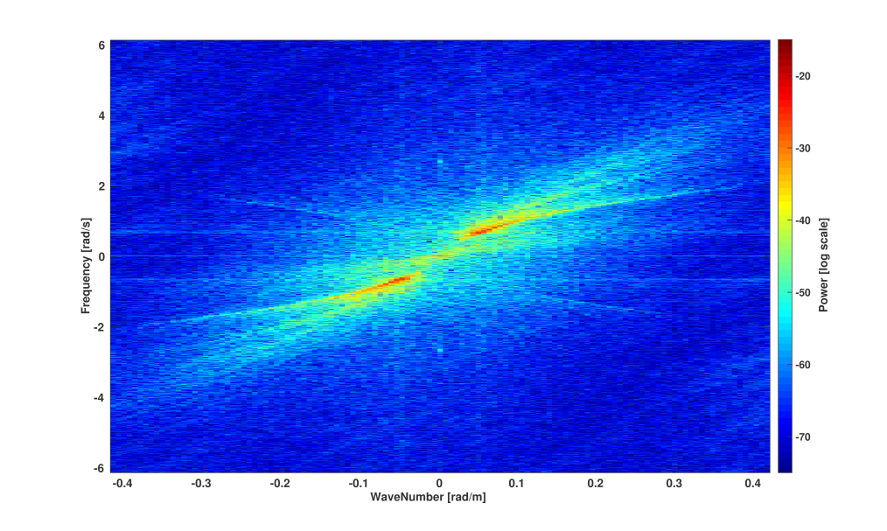
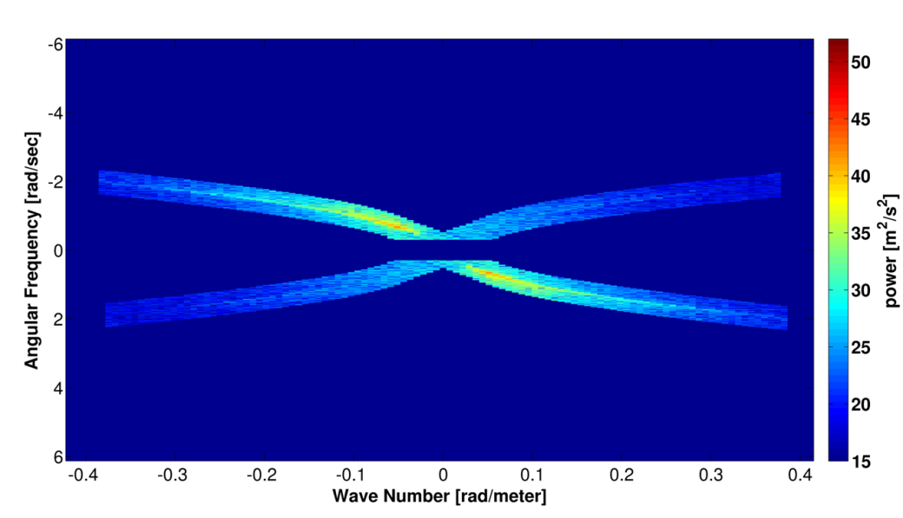
Use of Linear Wave Theory
Linear Dispersion Relation is used as a Signal Filter (Selection of Fundamental Mode)
Velocity Spectra NOT transformed to Surface Elevation Spectra (using Linear Wave Theory)

Slide 6
Buoy Data Processing
Acquisition of 3D Orbital Path
Calc. of Orbital Velocity Vectors from Horizontal Positions
Projection in Radar Antenna Viewing Direction
Bandpass Selection ([0.3 1.4] rad/s) because of Consistancy with Radar Data

Slide 7
Velocity Spectral Parameters
Significant Velocity $V_{s}$ = 4$\sqrt{\int_{ω_{min}}^{ω_{max}}{E_{v}}}$(ω) dω
Mean Frequency ${ }_{m1}$ = $\frac{\int_{_{min}}^{_{max}}{{ E}_{v}(}) d}{\int_{_{min}}^{_{max}}{{ E}_{v}(}) d}$
Peakedness Factor (Goda) $Q_{p}$=2 $\frac{\int_{_{min}}^{_{max}}{ {{ (E}_{v}())}^{2}} d}{{(\int_{_{min}}^{_{max}}{{ E}_{v}(}) d)}^{2}}$

Slide 8
Radar related Parameters
Range <-> Grazing Angle
Mean Confidence
Projection Power Loss (Spreading relative to Antenna Viewing Direction
P=$\frac{\iint{E(ω,{)\cos^{2}\left(−r\right)d}}ω d}{\iint{E(}ω,) dω d}$

Slide 9
Wave and Wind related Parameters
Hs (from Time Series)
Wave Steepness
(Hs and Wave Steepness are strongly correlated for our Data set, dominated by Wind Sea)
USTAR

Slide 10
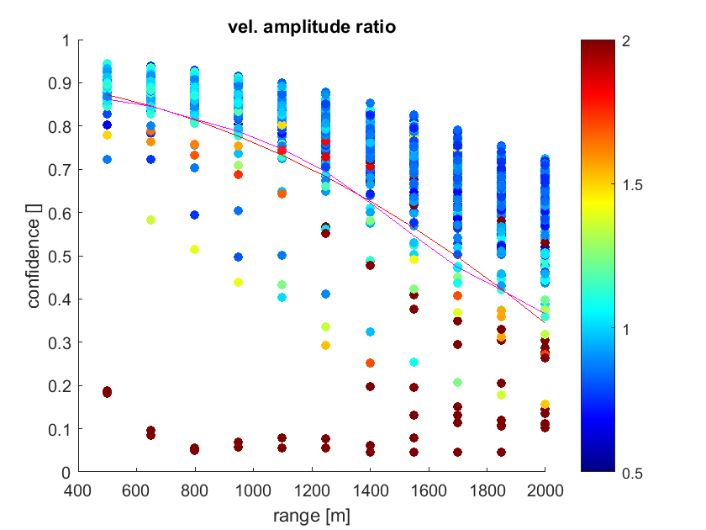
Data Cleaning
Range-Dependent Confidence Threshold

Slide 11
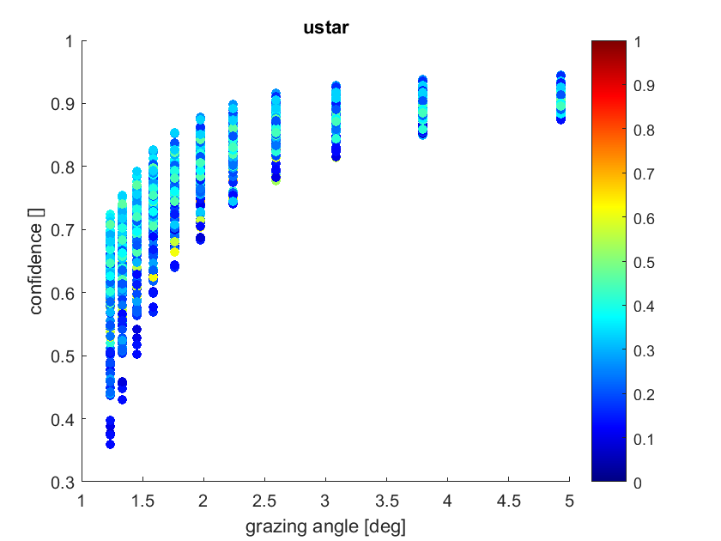
Confidence Dependency on USTAR

Slide 12
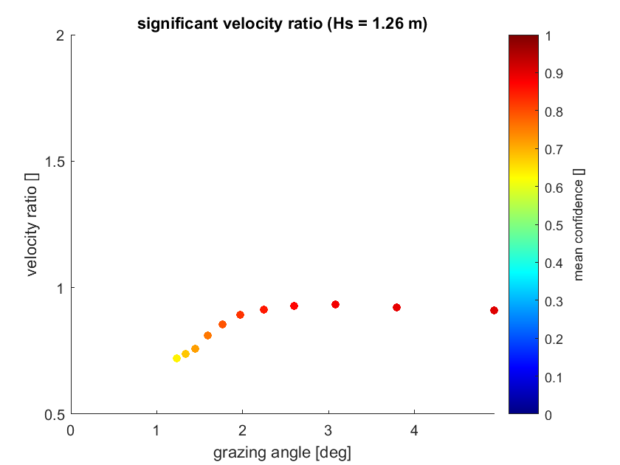
Significant Velocity Ratio Dependency on Grazing Angle

Slide 13
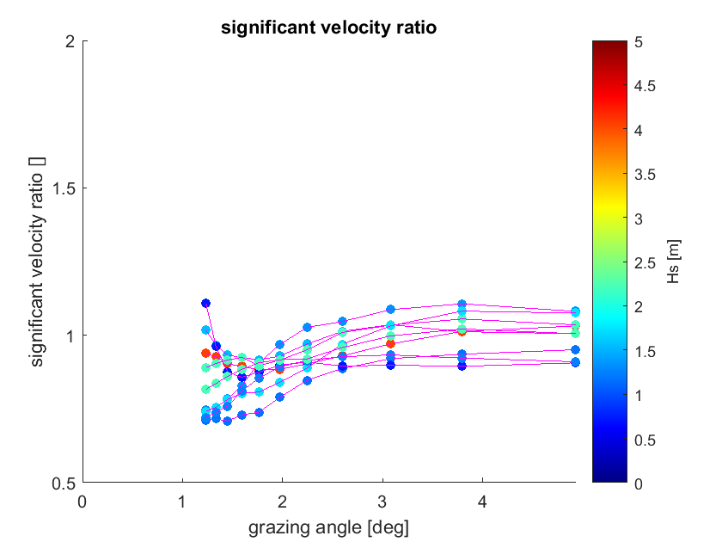
Significant Velocity Ratio Dependency on Grazing Angle
Near-Range:
BIAS: -0.0071
RMSE: 0.115
(larger sample)

Slide 14
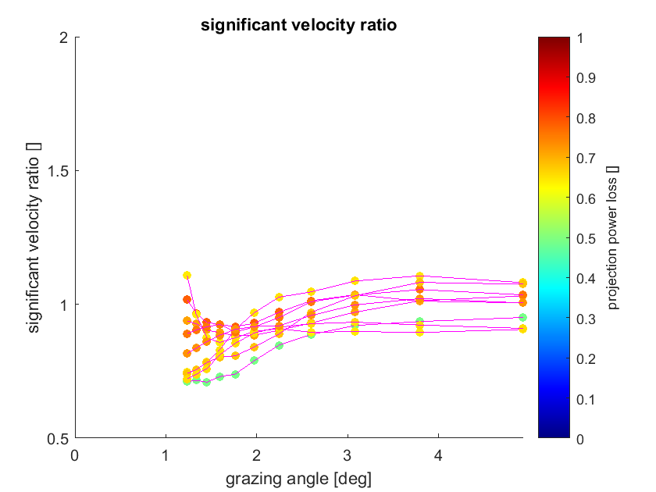
Significant Velocity Ratio Dependency on Grazing Angle
Near-Range:
BIAS: -0.0071
RMSE: 0.115
(larger sample)

Slide 15
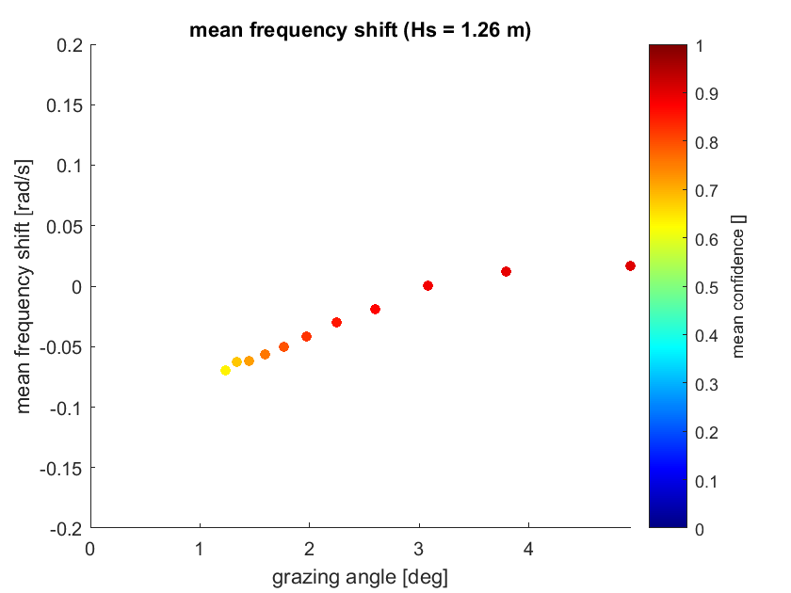
Frequency Shift Dependency on Grazing Angle

Slide 16
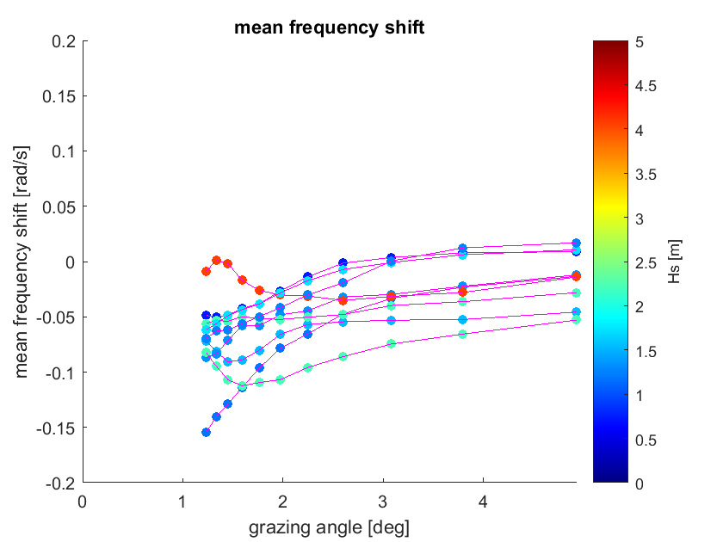
Frequency Shift Dependency on Grazing Angle
Near-Range:
BIAS: -0.0167 rad/s
RMSE: 0.0301 rad/s
(larger sample)

Slide 17
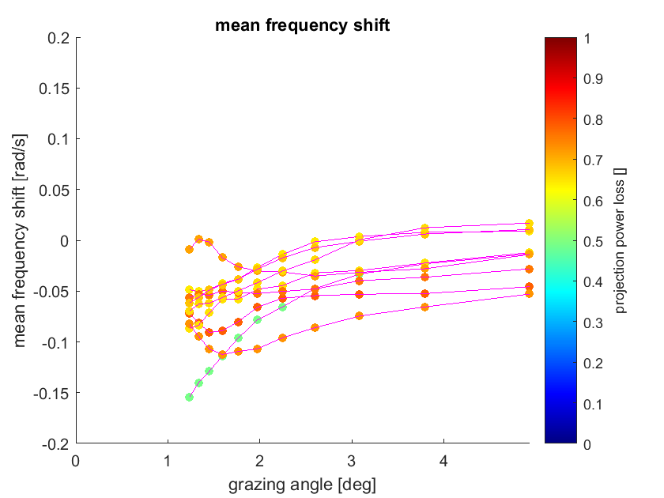
Frequency Shift Dependency on Grazing Angle
Near-Range:
BIAS: -0.0167 rad/s
RMSE: 0.0301 rad/s
(larger sample)

Slide 18
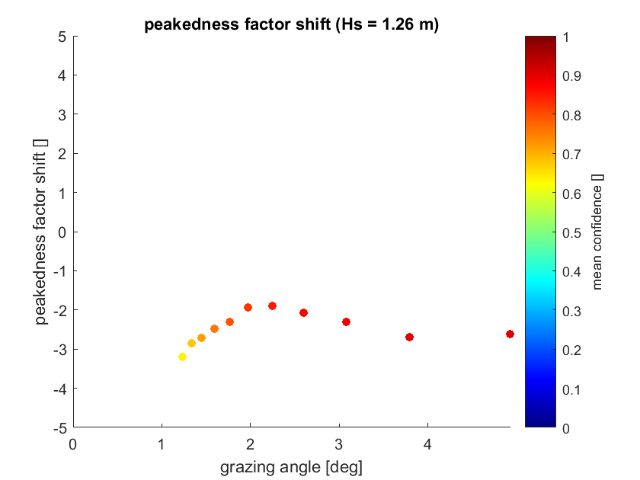
Peakedness Factor Shift Dependency on Grazing Angle

Slide 19
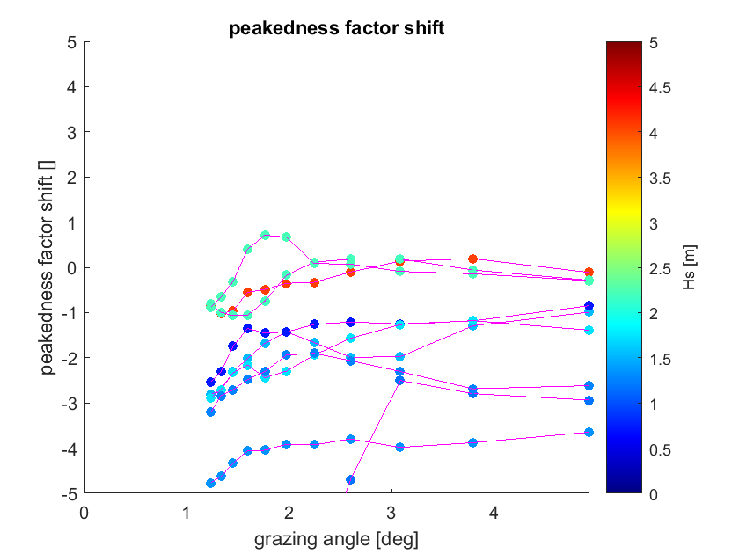
Peakedness Factor Shift Dependency on Grazing Angle
Near-Range:
BIAS: -1.6964
RMSE: 2.3261
(larger sample)

Slide 20
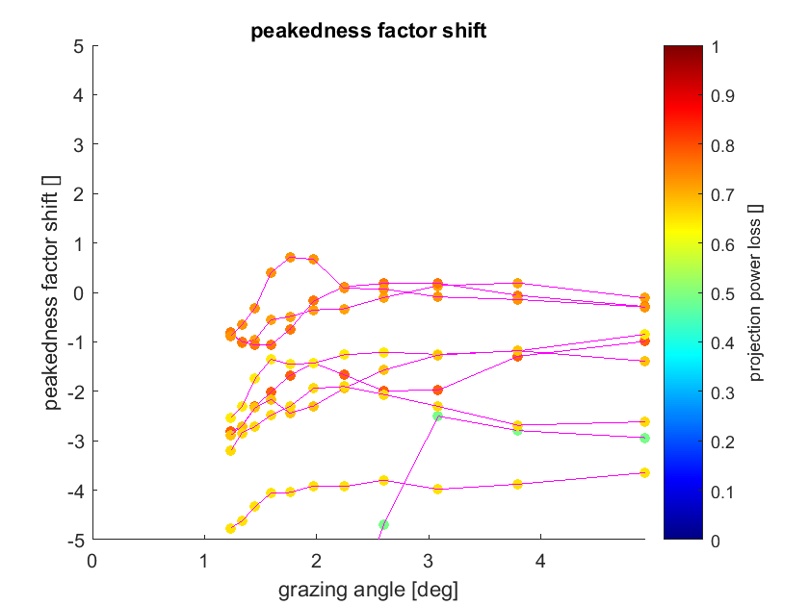
Peakedness Factor Shift Dependency on Grazing Angle
Near-Range:
BIAS: -1.6964
RMSE: 2.3261
(larger sample)

Slide 21
Correlation Analysis: Feature Vectors
f1 = Significant Velocity Ratio
f2 = Mean Frequency Shift
f3 = Peakedness Parameter Shift
f4 = Mean Confidence
f5 = Projection Power Loss Factor
f6 = Hs
f7 = Wave Steepness
f8 = USTAR

Slide 22
Near –Range Correlations
1
2
3
4
5
6
7
8
Significant Velocity Ratio 1
Mean Frequency Shift 2
Peakedness Parameter Shift 3
Mean Confidence 4
Projection Power Loss Factor 5
Hs 6
Wave Steepness 7
USTAR 8
Deviations of Spectral Parameters between Radar
and Buoy depend on the Sea State (Hs, Wave Ange,
and Directional Spread), but the Correlations are
weak

Slide 23
Summary
Limitations under Grazing Incidence Conditions (Grazing Angle < 2-3 deg.)
In the Near-Range the total Power of the Radar and Buoy Velocity Spectra are the same.
There is a negative Frequency Shift of the Radar relative to the Buoy Velocity Spectrum
The Radar Spectra are broader than the Buoy Spectra
These Deviations can be corrected in the Near-Range

